Slide 1
CAPSTONE PROJECT
BITCOIN PRICE PREDICTION
Presented By:
RAGHUL M
THANTHAI PERIYAR INSTITUE OF TECHNOLOGY - VELLORE
CIVIL DEPARTMENT

Slide 2
OUTLINE
Problem Statement
Proposed System/Solution
System Development Approach
Algorithm & Deployment
Result
Conclusion
References

Slide 3
PROBLEM STATEMENT
Bitcoin Price will always fluctuate rapidly in short period of time, so that investors and traders cannot predict the future price so they cannot invest in cryptocurrencies.
Bitcoin has high volatility in price.
Uncertainty in Investment Decisions.
Need for Data-Driven Insights.
Having Opportunity for Predictive Analytics.

Slide 4
PROPOSED SOLUTION
We are using data science techniques for predicting the price prediction of bitcoin
LSTM where it is called Long Short Term Memory, by using this method we can predict the bitcoin price.
Data Set needed for this process is collected from the finance.yahoo.com where the price of bitcoin from 2014 to 2023 are collected.
The collected dataset are in format of in csv extension.
Then the collected dataset are preprocessed.
Insightful informations are then obtained.

Slide 5
SYSTEM APPROACH
Firstly, the dataset are collected form the finance.yahoo.com where it stores the price history varying from hours to minutes from 2014 to 2024 (till date),
And then dataset is downloaded from that website
Using VS code, we are installing the python, jupyter notebook and ananconda and then importing dataset in the folder.
Creating the New jupter note book file.
Applying the necessary corrections functions to the dataset file to handle the missing values.
And creating model to predict the price of bitcoin.

Slide 6
ALGORITHM & DEPLOYMENT
Long Short-Term Memory (LSTM) Networks: A type of recurrent neural network (RNN) capable of capturing long-term dependencies and nonlinear relationships in sequential data.
By using the LSTM algorithm, dataset are analyzed.
And the LSTM deployed in the Github respository where the dataset, program file, Readme file were added on the repository.

Slide 7
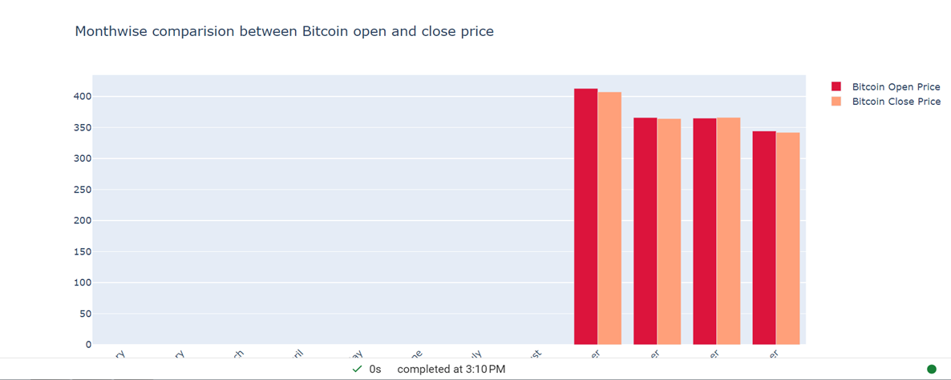
RESULT

Slide 8
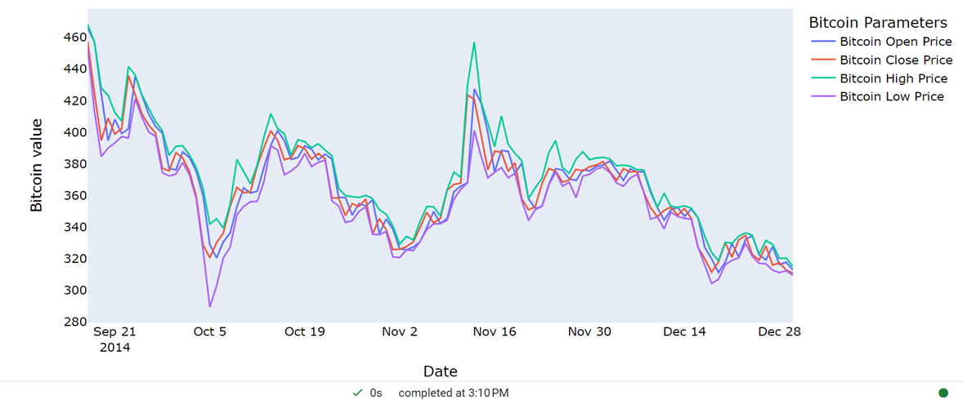

Slide 9
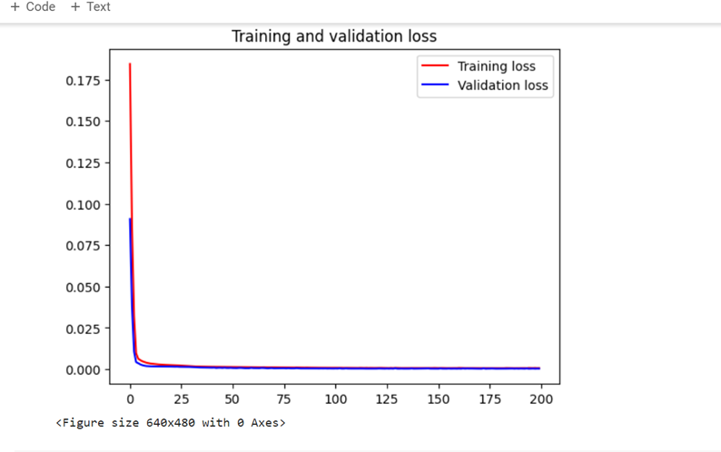

Slide 10
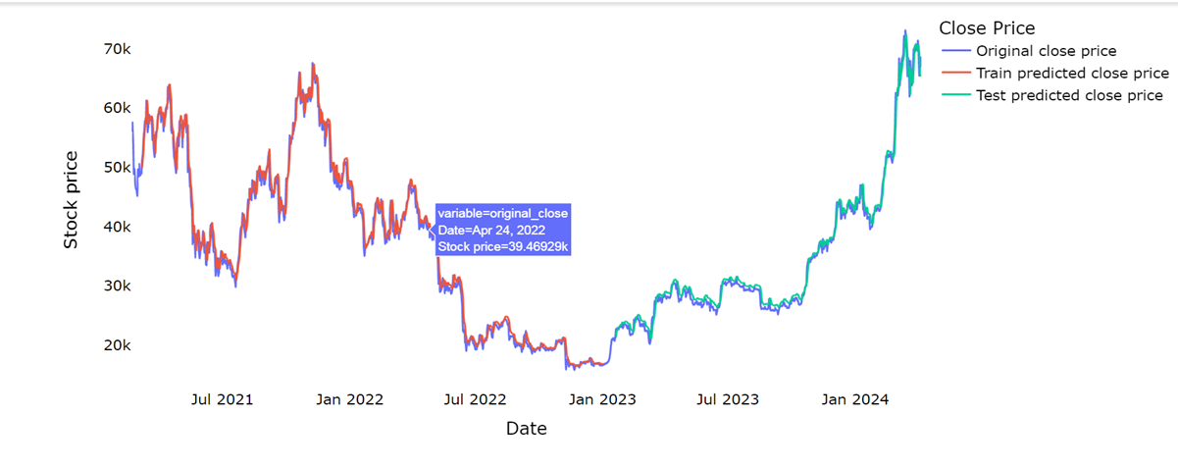

Slide 11
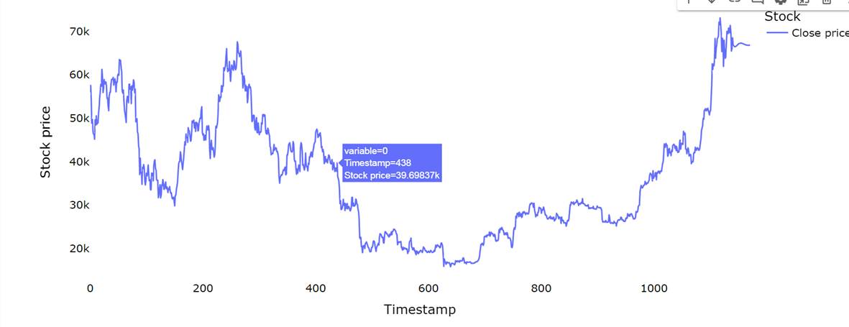

Slide 12
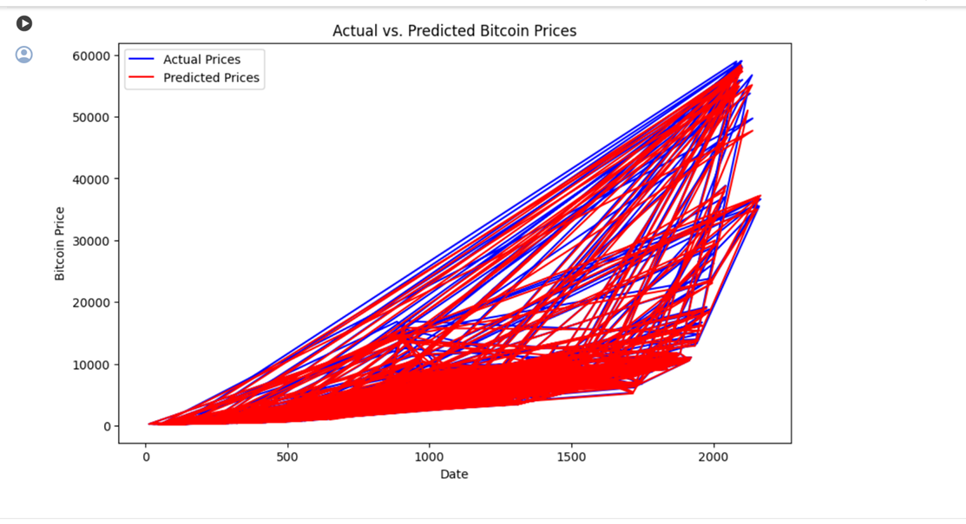

Slide 13
CONCLUSION
In conclusion, we see about the bitcoin price prediction using the data science where bitcoin prices are very volatile, by using data science we overcome this problem where LSTM method is used.
From this project, Investors and traders can easily take right decision to invest in bitcoin
It is always important to take quality data where the dataset must contain all values without non values and it should be in the format of csv.
From the project, we have known how to predict the bitcoin price using lstm and we can apply the same principles and functions to find any other cryptocurrencies prices.
Eventhough, if you find the graph , you shouldn’t reley on graph only because market is unpredictable and have sentiment emotions.

Slide 14
REFERENCES
From the link, dataset is download.
-https://finance.yahoo.com/quote/BTC-USD/history/
From the youtube videos, I have learnt that how to develop functions to find bitcoin price predictions.
The link are
-https://youtu.be/vXE7eqGxRVY?si=GpopW_sZj93KbPOV
-https://youtu.be/p-QY7JNGD60?si=ZMmLDZO5J_ZU7NsQ
From the youtube video, I have learnt that how Github works and working with Github.
-https://youtu.be/T6o3Ci8Ieag?si=4EUwkeyAQ-8HXnIo
From the youtube videos, I have learnt Python, Visualstudios, Anaconda programs.
-https://youtu.be/_uQrJ0TkZlc?si=C84Y0srDFX7x6MTV
-https://youtu.be/E9U-EBG8jVk?si=6isNfGwidn9gJCwu

Slide 15
THANK YOU

